Slide 1


Team 205 – Robotic Arm to Assist Motorized Chair Users
Industry Sponsor: PPMD, Keith Van Houten
Faculty Advisor: Stephen Moyer
Team Lead: Brooke Harrington
Team Members: Cavan Moriarty, Omar Abuljobain, Justin Lee, and Andrew Baum
Notes:
Brooke: Good afternoon! My name is Brooke Harrington and I'm the team lead for team 205. My team and I have been and will continue to work closely with Parent Project Muscular Dystrophy, better known as PPDM, which is a non-profit organization. Not only are we in contact with Kieth Van Houten, our industry sponsors, but also an amazing group of individuals who have muscular dystrophy. Through their consultation, the team will fabricate a robotic arm to assist motorized chair users.

Slide 2
Agenda
System Decomposition
Background, Problem, Value Proposition
System Architecture
System Requirements
Conceptual Design
Team Concepts
Concept Screening and Scoring
Final Concept
Preliminary Design
System Diagram, Electrical Diagram
CAD Models
Prototypes, Engineering Calculation
Project Management
Risk and Mitigation Strategies
Budget
Project Timeline
Notes:
Brooke

Slide 3
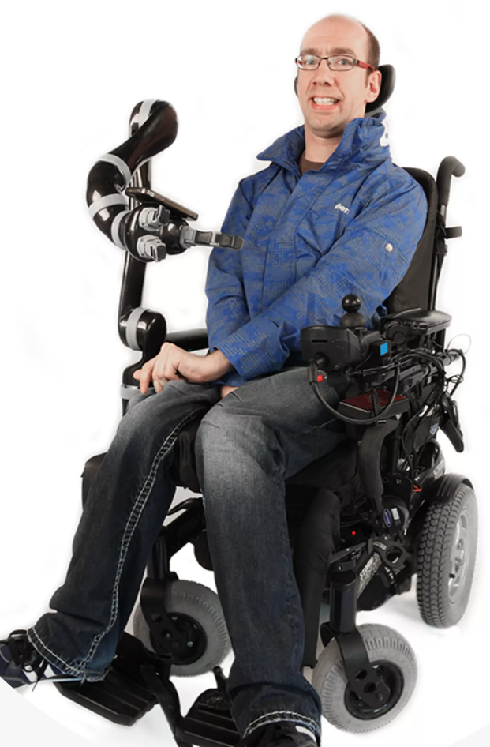
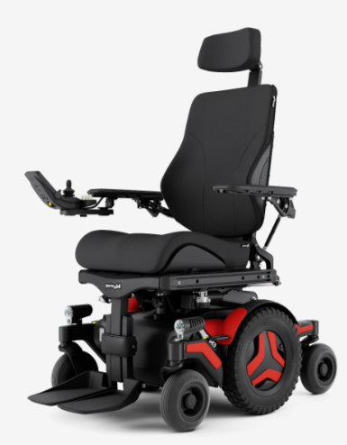
Background on Duchenne Muscular Dystrophy (DMD)
DMD is a progressive disorder that deteriorates muscles over time
Requires those with DMD to use motorized wheelchairs such as the Permobil M3 and Quantum
People with DMD have limited range of motion (ROM) and often require a caretaker or robotic device to help with everyday tasks
Figure 1: Robotic Arm Mounted on Wheelchair
Figure 2 Permobil M3 Corpus
System Decomp.
Conceptual Design
Preliminary Design
Proj. Management
Notes:
Brooke

Slide 4
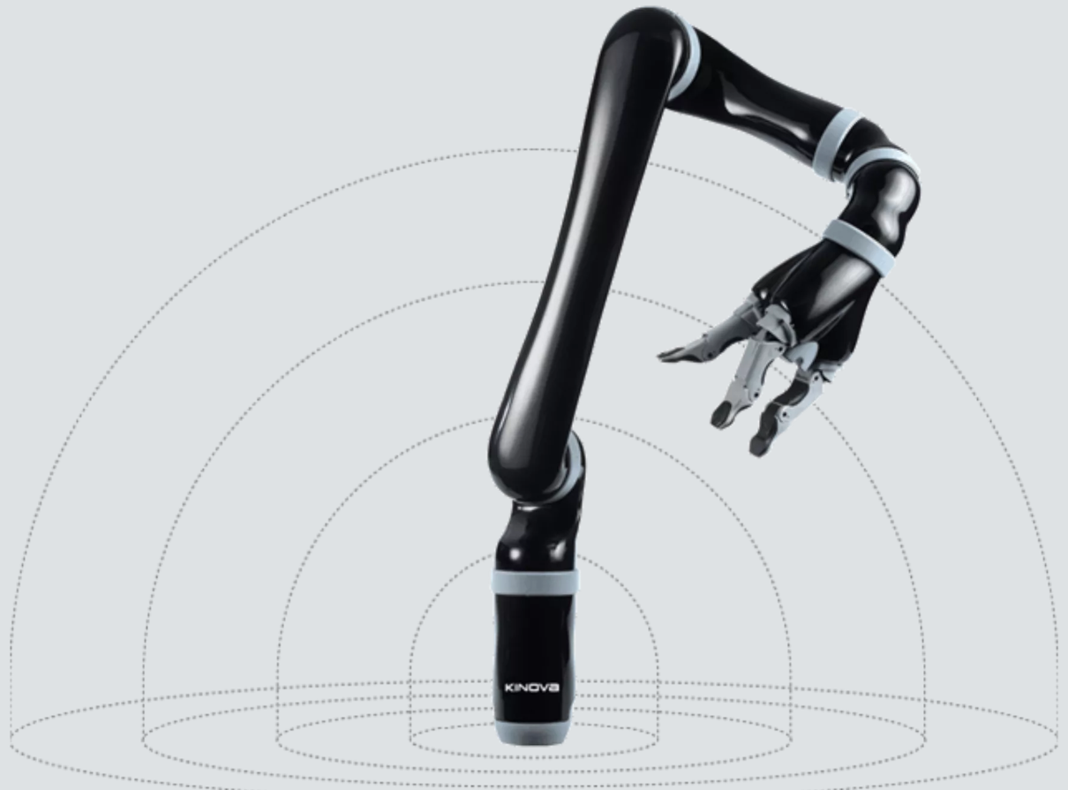
Problems with the Current ROM Assistive Robot
Current solutions such as the Kinova JACO robotic arm are:
Too Expensive (>$60,000)
Difficult to Control
Large/Bulky
Difficult to remove for travel
Team 205 will develop an affordable, simple to control robotic arm that will accomplish two high value functions: pushing handicap door and elevator buttons, and bringing a cup to the user's face
Figure 3: Kinova JACO robotic arm
Figure 4: Robotic Arm Mounted on Wheelchair
System Decomp.
Conceptual Design
Preliminary Design
Proj. Management
Notes:
Brooke
The team will focus on the button pushing task and if time permits, complete the cup task once the button task is fully completed

Slide 5
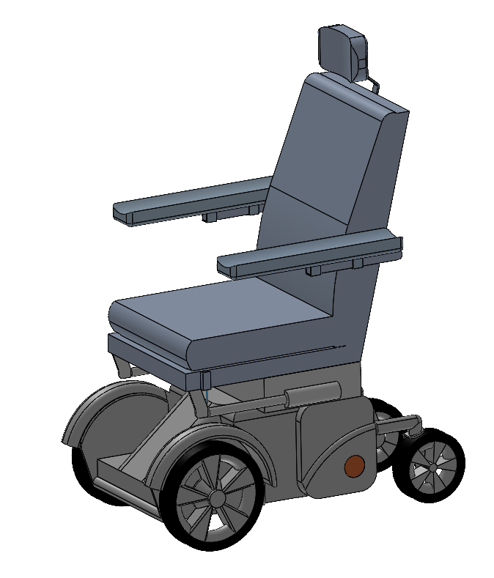
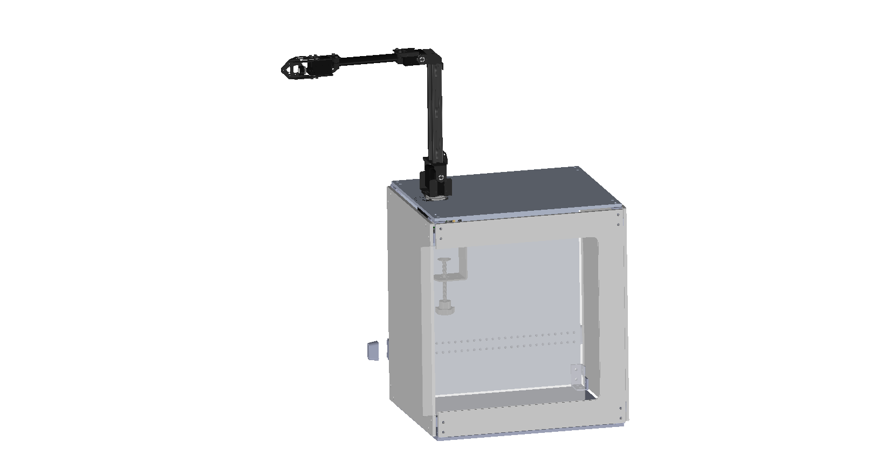
For individuals with DMD who require ROM assistance, an affordable robotic aid would provide assistance with everyday tasks
Perform high value functions such as pushing a handicap door button
Simple controls allow easier access to ROM assistance
Integrate robotic manipulation capabilities onto powered wheelchairs at an affordable price
System Decomp.
Conceptual Design
Preliminary Design
Proj. Management
Notes:
Brooke

Slide 6
System Level Objectives
Technical Requirement ID | Requirement | Verification Method
TR 1.1.0 | The robot shall be controlled manually by a joystick and should have the ability to program automatic functions accessed through a button push or voice activation | Test
TR 1.2.0 | The robot shall have no more than six degrees of freedom to reduce the complexity of controls | Inspection
TR 1.3.0 | The robot shall have an operating radius that spans a minimum of 5 inches to a maximum of 2 feet from mount location with 180 degrees of rotation total | System Test
TR 1.4.0 | The robot should receive power from the motorized wheelchair battery and should include a backup battery | Analysis
System Decomp.
Conceptual Design
Preliminary Design
Proj. Management
Notes:
Cavan
Hello, my name is cavan moriarty, I will be covering our system level objectives, the requirements we derived from those, as well as the three subsystems of our project
What you can see here are the four primary objectives we developed with our sponsors. These objectives focus on reducing the complexity of the final design, while not losing certain key features found on high end commercial models.

Slide 7
Derived Requirements
Technical Requirement ID | Requirement | Verification Method
TR 1.1.1 | The joystick shall be attached to the wheelchair such that the user can comfortably manipulate the controls within their range of motion | User Testing
TR 1.1.2 | Automatic functions such as bringing a water bottle to the user shall be independent of the joystick and should operate without any joystick inputs, utilizing buttons instead | System Test
TR 1.1.3 | The arm shall mount in a location that does not interfere with the users seating or ability to pass through an ADA compliant door | Physical Inspection
TR 1.3.1 | The device should be able to reach and depress handicap and elevator buttons between 34” and 48” off the floor as specified by ADA standards | System Test
TR 2.1.0 | The robot electronics shall be contained in a weather resistant enclosure | Material Test
TR 3.1.1 | The robot shall be disassembled and reassembled for the inspection and cleaning of parts | Timed Test or PM/M Plan Development
TR 4.1.0 | The system shall be optimized to contain minimum safety hazards including sharp edges and pinch points for user safety | Visual/Physical Inspection
TR 5.1.0 | The robot shall have an accessible kill switch between the battery and circuitry to protect against unexpected energization | System Test
TR 5.2.0 | The robot shall have physical/program limiters to prevent the robot from intrusively interacting with the user | System Test
System Decomp.
Conceptual Design
Preliminary Design
Proj. Management
Notes:
Cavan
From those objectives, we were able to develop our list of requirements, which i will go over the key ones here.
First, in order to not reduce the accessibility of the wheelchair, we have that the wheelchair must be able to fit through a standard door when the unit is attached
Secondly, the robotic arm must be able to reach the standard height for elevator and handicap buttons
And our final key requirement is that the robot will have built in motion limiters, to prevent it from harming the user in any way
The other requirements relate to the safety and usability of the product, clarifying methods through which we can make it a better experience for the user

Slide 8
Changes to Requirements Upon Further Discussion and New Information
Requirement ID | Old Requirement Description | Updated Requirement Description | Reason
TR 1.1.0 | The robot shall be controlled manually by a joystick and should have the ability to program automatic functions accessed through a button push or voice activation | The robot shall be controlled manually by a joystick and should have the ability to program automatic functions accessed through a button | Voice activation exceeds the scope of the project Manual joystick control was emphasized
TR 1.3.1 | New Requirement – Verification through system test | The device should be able to reach and depress elevator buttons and the handicap door button between 34" and 48" as specified by ADA standards | High value functions were narrowed down and updated, necessitating a new requirement
TR 1.4.0 | The robot should receive power from the motorized wheelchair battery and should include a backup battery | The robot and necessary electronics should receive power from a rechargeable battery independent of the wheelchair electronics | Possibility that power draw from the wheelchair battery will throw a fault or error on the wheelchair and render it unusable
System Decomp.
Conceptual Design
Preliminary Design
Proj. Management
Notes:
Cavan
After further discussion with our sponsors, we came to some clarifications on our previous objectives. To elaborate on those, is this slide
First we simplified our proposed method of controls, limiting it to a joystick instead of voice command
We also specified a target range for the button pressing, allowing us to be more precise in our tests and final design
Lastly we altered the design so that instead of connecting directly to the wheelchairs battery, its power source would be independently stored in the unit, allowing the system to be modular, easily removed and easily replaced

Slide 9
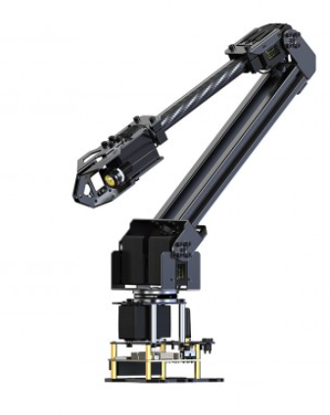
Breaking the System Down – 3 Subsystems
System
Assistive Robotic for Motorized Wheelchair
Subsystem
Robot Frame
Configuration Item
Linkages
Mount
End Effector
End-Effector
Robot Frame
Function
Provides Structure to the Arm
Defines geometry used in software development
Provides instillation locations for motors and controllers
Attaches robot and UI/controller to assistive electric wheelchair
Allows interaction with environment and provides method for completing high value functions
Mount
Linkages
System Decomp.
Conceptual Design
Preliminary Design
Proj. Management
Notes:
Cavan
With that out of the way, we have our subsystems, which are broken down into three aspects
The first is the frame, which consists of the linkages, the mount, and the end effector. Where the linkages provide the structure and geometry of the robot, the mount connects it to the box, and the end effector interacts with the environment

Slide 10
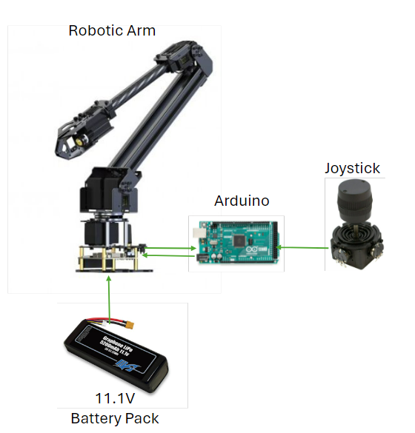

Breaking the System Down – 3 Subsystems
System
Assistive Robotic for Motorized Wheelchair
Subsystem
Electronics / Circuitry
Software / Programming
Configuration Item
Servo / Stepper Motors
Arduino / Raspi
Peripherals / UI
User Inputs
Robot Inputs
Function
Moves the linkages of the robot for precise positioning in 3-D
Translates user commands to robot commands, platform for software development
Allows for user control, interface for taking commands from the user
Receives and translates user inputs for position or pre- programmed actions
Translates user commands into motor inputs for robot interaction with environment
Python
System Decomp.
Conceptual Design
Preliminary Design
Proj. Management
Notes:
Cavan
Our next subsystem is the electronics and circuitry, which consists of the servo, arduino, and User Interface
This system dictates how we will be able to control the robot, and how our users will be able to interact with it. With the servos actuating the frame, an arduino being the primary processor, and the UI being a joystick control.
This leads us to our last subsystem, which is the software that the robot will be running on.
This system consists of the inputs, both those by the user and the feedback from the robot. The primary task of this subsystem is to take these inputs and translate them to the movement of the frame.

Slide 11
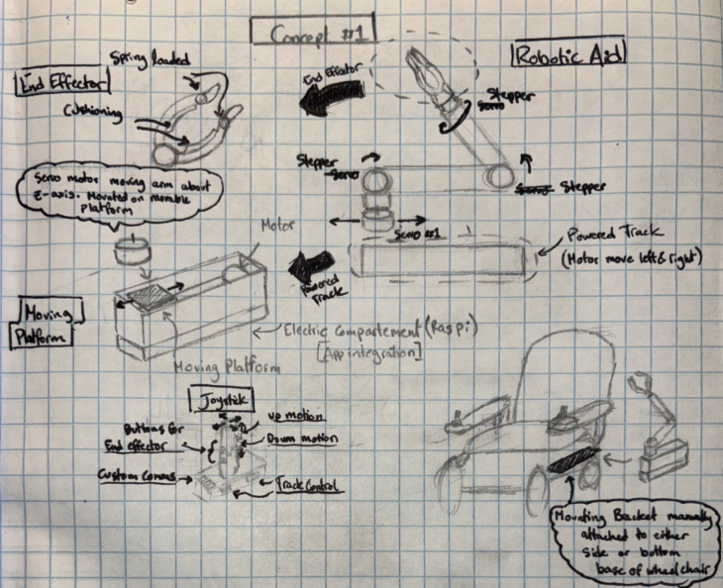
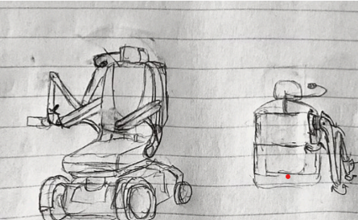
Team Members Generated Individual Concepts to be Considered
Cushioned end effector, Spring loaded fingertips
Motors
Voice Control
8 Degree of Freedom Robotic Arm
Powered Track that Slides Arm
Compact Backpack Mounting
Motors
Uses a joystick with buttons for control
Mounts on the Unitrack under the armrest
Figure 6: Justin Omar Combo Robotic Arm
Figure 7: Brooke Cavan Over the Shoulder Robotic Arm
System Decomp.
Conceptual Design
Preliminary Design
Proj. Management
Notes:
Omar
Through understanding of requirements and derived functions…
(Less important, less time to spend on)

Slide 12
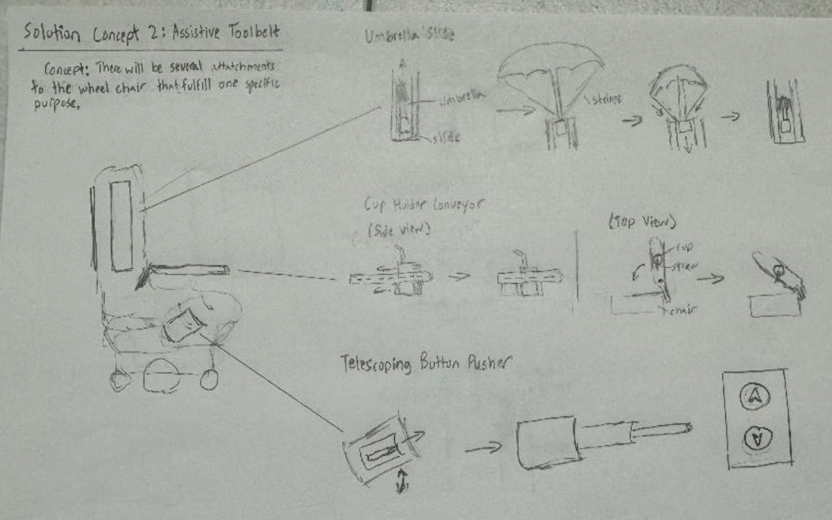
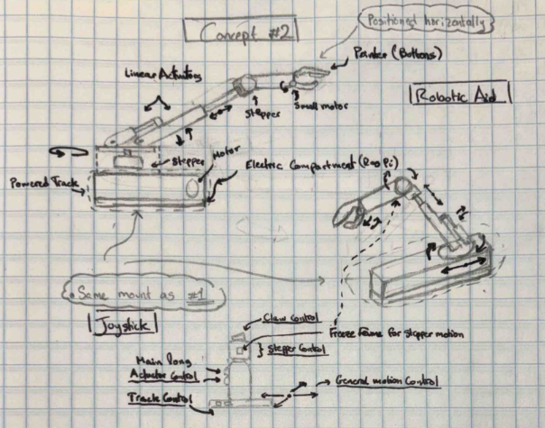
Team Members Generated Individual Concepts to be Considered
Umbrella mounted on side of backrest, cup holder mounted on the armrest, button pusher mounted on side of the seat
Umbrella slide deployer
Linear Actuators
Servos
Cup holder conveyor belt
Telescoping Button Pusher
Figure 8: Justin AJ Combo Assistive Toolbelt
Figure 9: Omar Track/Pneumatic Arm
System Decomp.
Conceptual Design
Preliminary Design
Proj. Management
Notes:
Omar

Slide 13
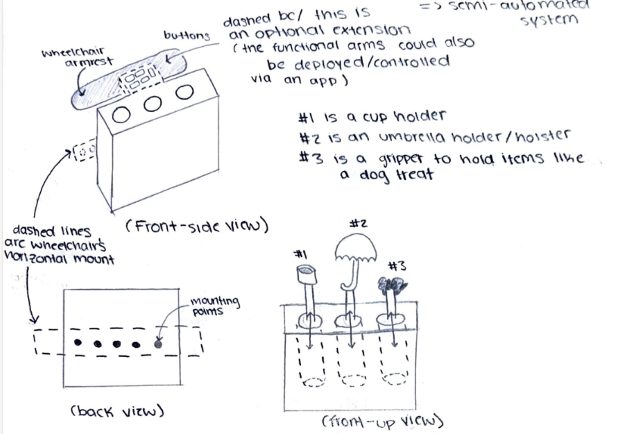
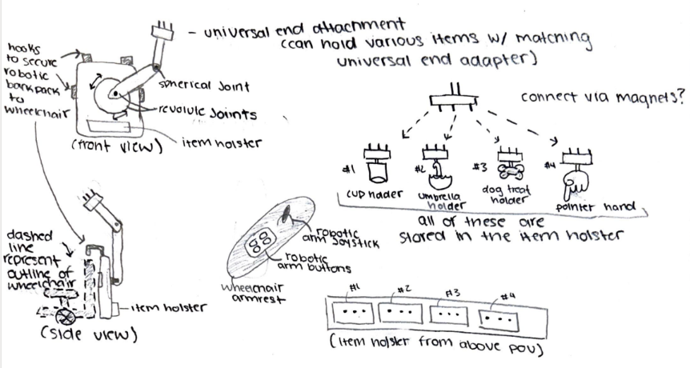
Team Members Generated Individual Concepts to be Considered
Figure 10: Combo Utility Box
Figure 11: Brooke Multi End Effector
System Decomp.
Conceptual Design
Preliminary Design
Proj. Management
Notes:
Omar

Slide 14
Concept Screening Narrowed Down the Teams Concepts
CONCEPT SCREENING
Criteria | Justin Omar Combo Robotic Arm | Brooke Cavan Combo Over the Shoulder Arm | Justin AJ Combo Assistive Toolbelt/Button Pusher | Omar Track Pneumatic Arm | Combo Utility Box (all in one) | Brooke Multi End Effector
Operating Radius | + | 0 | - | 0 | - | +
Number of Inputs to control device | 0 | 0 | + | 0 | - | -
Number of actuators to control device | 0 | 0 | + | + | + | -
Size | + | 0 | 0 | - | - | -
Cost | + | 0 | 0 | - | + | -
Safety | + | 0 | + | 0 | - | +
Failure Modes | 0 | 0 | 0 | - | + | -
Device Integration into chair | 0 | 0 | 0 | + | 0 | +
Ease of Installation | 0 | 0 | 0 | - | 0 | +
Net “+” | 4 | 0 | 3 | 2 | 3 | 4
Net “-” | 0 | 0 | 1 | 4 | 4 | 5
Net | 4 | 0 | 2 | -2 | -1 | -1
Rank | 1 | 3 | 2 | 6 | 4.5 | 4.5
Continue? | Continue | Continue | Continue | Eliminate | Eliminate | Eliminate
A “+” indicates that the concept is better than the reference for that criteria
A “0” indicates it is equal in performance as the reference
A “-” indicates the concept is worse than the reference for that criteria
System Decomp.
Conceptual Design
Preliminary Design
Proj. Management
Notes:
Omar
Operating Radius – how far can the concept reach from the mounting location
Number of inputs to control device – how many buttons are necessary to operate the system
Number of actuators – how many actuators are necessary to fully operate system
These two refer to the overall “simplicity” of the system
Size – refers to build envelope –cost probably don’t need to elaborate
Cost - probably don’t need to elaborate
Safety – important because we don’t want the robot to harm the user
Failure Modes – how many ways can the system fail or break
Device integration – How well does the device fit onto chairs existing geometry
Ease of installation – How many parts and tools are required to install the solution onto the motorized wheelchair

Slide 15
Concept Scoring Weighed the Importance of Each Criteria for Final Selection
Rated on a 1-4 scale where 1 and 2 are worse than the reference and 4 is better than the reference. Reference is 3
CONCEPT SCORING
 |  | Justin Omar Combo Robotic Arm |  | Brooke Cavan Combo Over the Shoulder Arm |  | Justin AJ Combo Assistive Toolbelt/Button Pusher
Criteria | Weight | Rating | Score | Rating | Score | Rating | Score
Operating Radius | 10% | 4 | 0.4 | 3 | 0.3 | 2 | 0.2
Number of Inputs to control device | 15% | 3 | 0.45 | 3 | 0.45 | 4 | 0.6
Number of actuators to control device | 10% | 3 | 0.4 | 3 | 0.3 | 4 | 0.4
Size | 15% | 3 | 0.45 | 3 | 0.45 | 3 | 0.45
Cost | 10% | 3 | 0.4 | 3 | 0.3 | 3 | 0.3
Safety | 15% | 4 | 0.6 | 3 | 0.45 | 4 | 0.6
Failure Modes | 10% | 3 | 0.3 | 3 | 0.3 | 4 | 0.4
Device Integration into Chair | 10% | 3 | 0.3 | 3 | 0.3 | 3 | 0.3
Ease of Instillation | 5% | 3 | 0.15 | 3 | 0.15 | 4 | 0.2
Total Score |  | 3.25 |  | 3 |  | 3.45
Rank |  | 2 |  | 3 |  | 1
Continue? |  | Develop |  | Discard |  | Develop
System Decomp.
Conceptual Design
Preliminary Design
Proj. Management
Notes:
Omar
Two final concepts were taken back to customer to be discussed, determined that the robotic arm would be the concept to continue and eliminated the assistive toolbelt concept

Slide 16
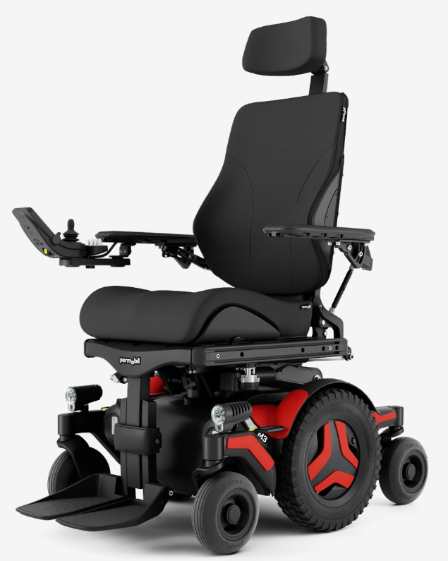
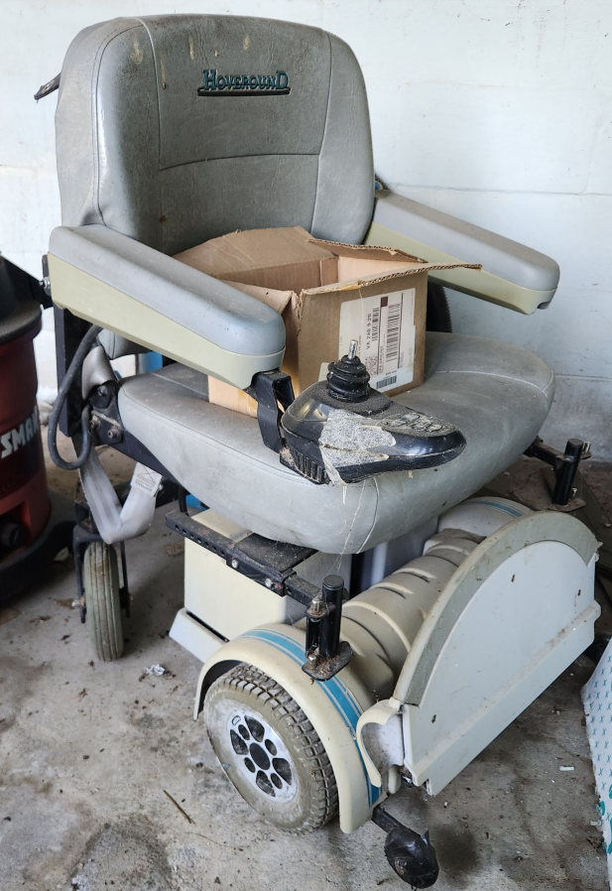
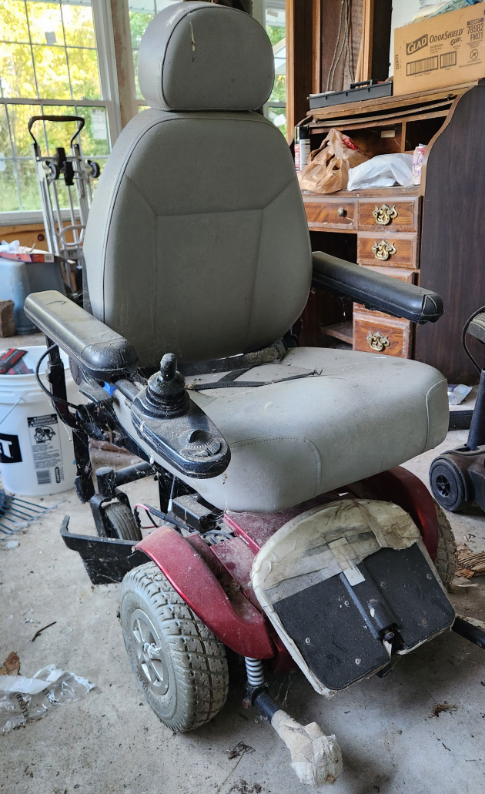
Assumptions for the Robotic Arm Concept
An off the shelf robotic arm will be purchased and integrated into the wheelchair
The Waveshare robotic arm is controlled by connecting to a website, but an Arduino can be connected allowing for other methods of control
Wheelchair donations from QL+ will be modified to resemble the structure of the Permobil M3 for testing purposes
The concept will mount to the Permobil Unitrack which is screwed into the seat of their motorized wheelchairs
Unitrack
Figure 13. Donated Hoveround Chair
Figure 14. Donated Jazzy Chair
Figure 15: Permobil M3 Corpus Unitrack
Figure 12: Waveshare Low-Cost Robotic Arm
System Decomp.
Conceptual Design
Preliminary Design
Proj. Management
Notes:
AJ
Mention that the idea is to develop something that can be easily replicated in the future if this project continues into the following years. Purchasing a ots robotic arm means people can do it themselves (open source type thing)

Slide 17
System Diagram
Robotic Arm:
Frame
Motors
End Effector
Motor Inputs
Joystick (Controller)
User Control Inputs
Arduino
Position Feedback
Power
Power
Battery
Kill Switch
System Decomp.
Conceptual Design
Preliminary Design
Proj. Management
Notes:
AJ

Slide 18
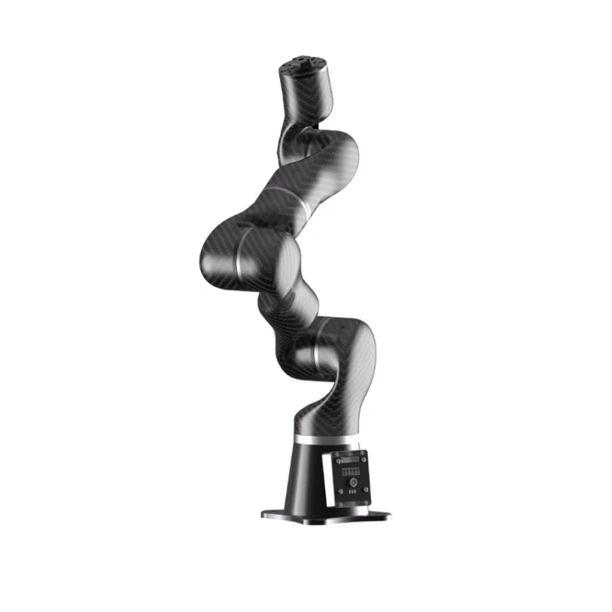
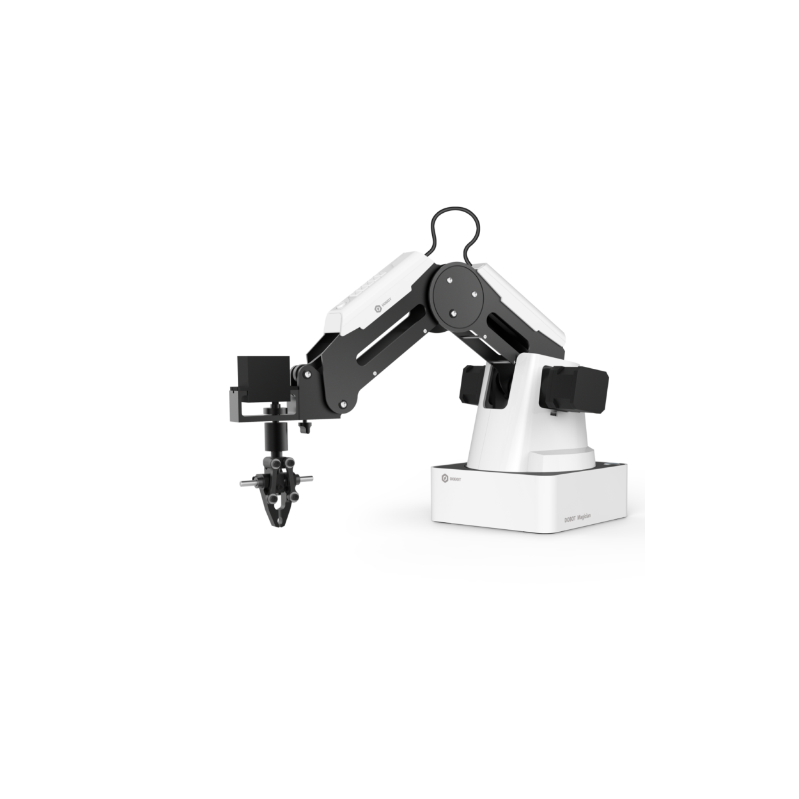
Benchmarking
 | Waveshare RoArm-M2 | TONIFISHI STR400 | Dobot Magician
Price | $189.99 | $3277.67 | $1690
Payload Capacity | 500g | 1500g | 500g
Weight | 826g | 2.8kg | 3.4kg
DOF | 4 | 6 | 4
Reach | 500mm (19.6in) | 626.75mm (24.76in) | 320mm (12.6in)
Programming Language | Open source | Open source | Open source
End Effector | Included | Excluded | Included
Figure 16:Waveshare RoArm-M2
Figure 17: Tonifshi STR400 Robotic Arm
System Decomp.
Conceptual Design
Preliminary Design
Proj. Management
Figure 17: Dobot Magician Robotic Arm
Figure 18: Dobot Magician
Notes:
AJ

Slide 19
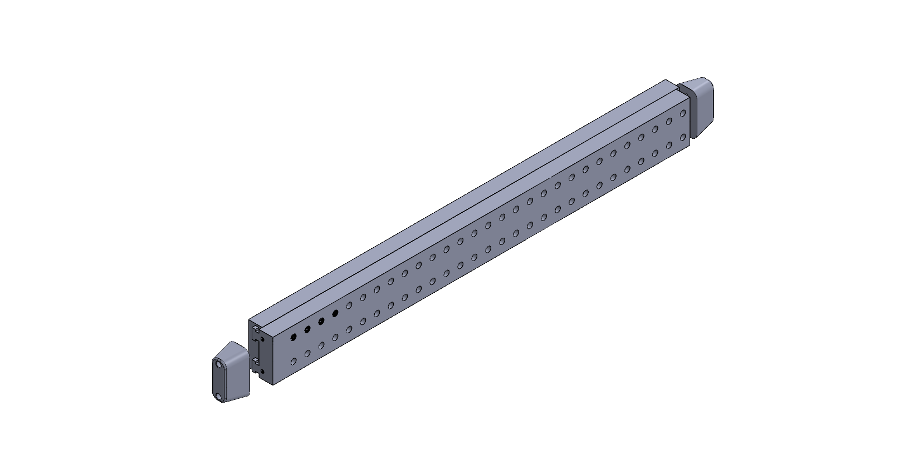
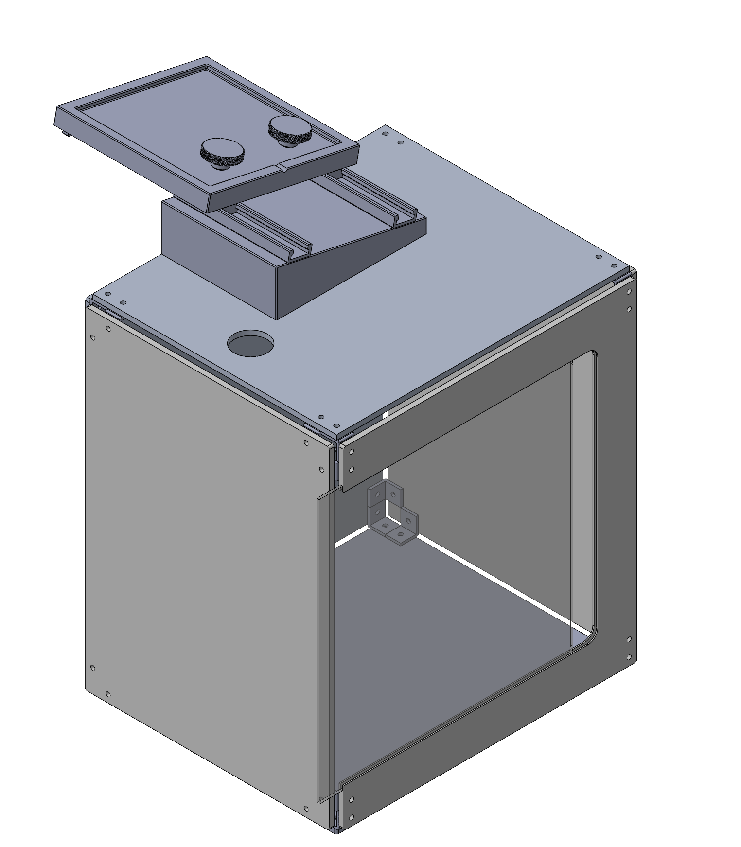
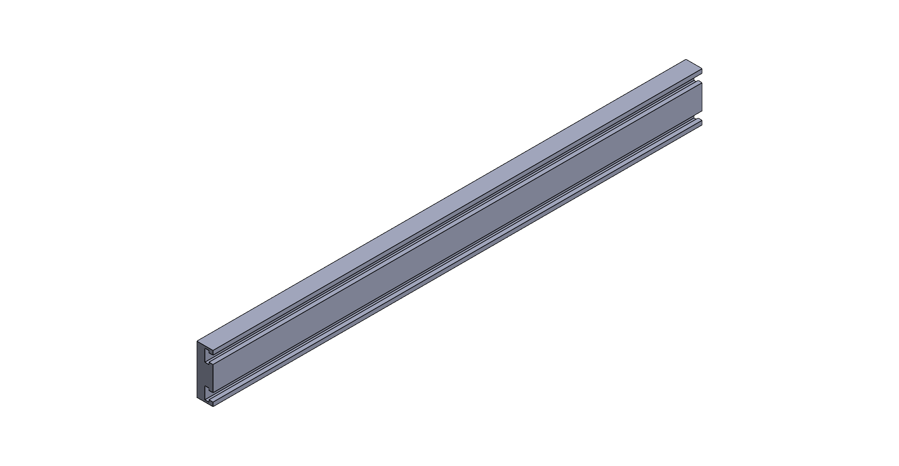
CAD Models
Unitrack, bolted to the wheelchair
System Decomp.
Conceptual Design
Preliminary Design
Proj. Management
Notes:
Justin

Slide 20
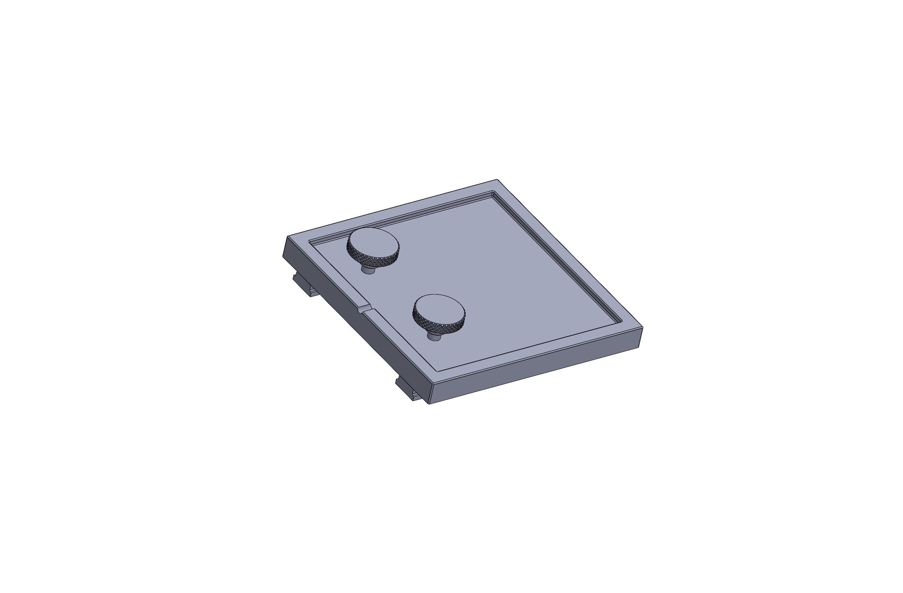
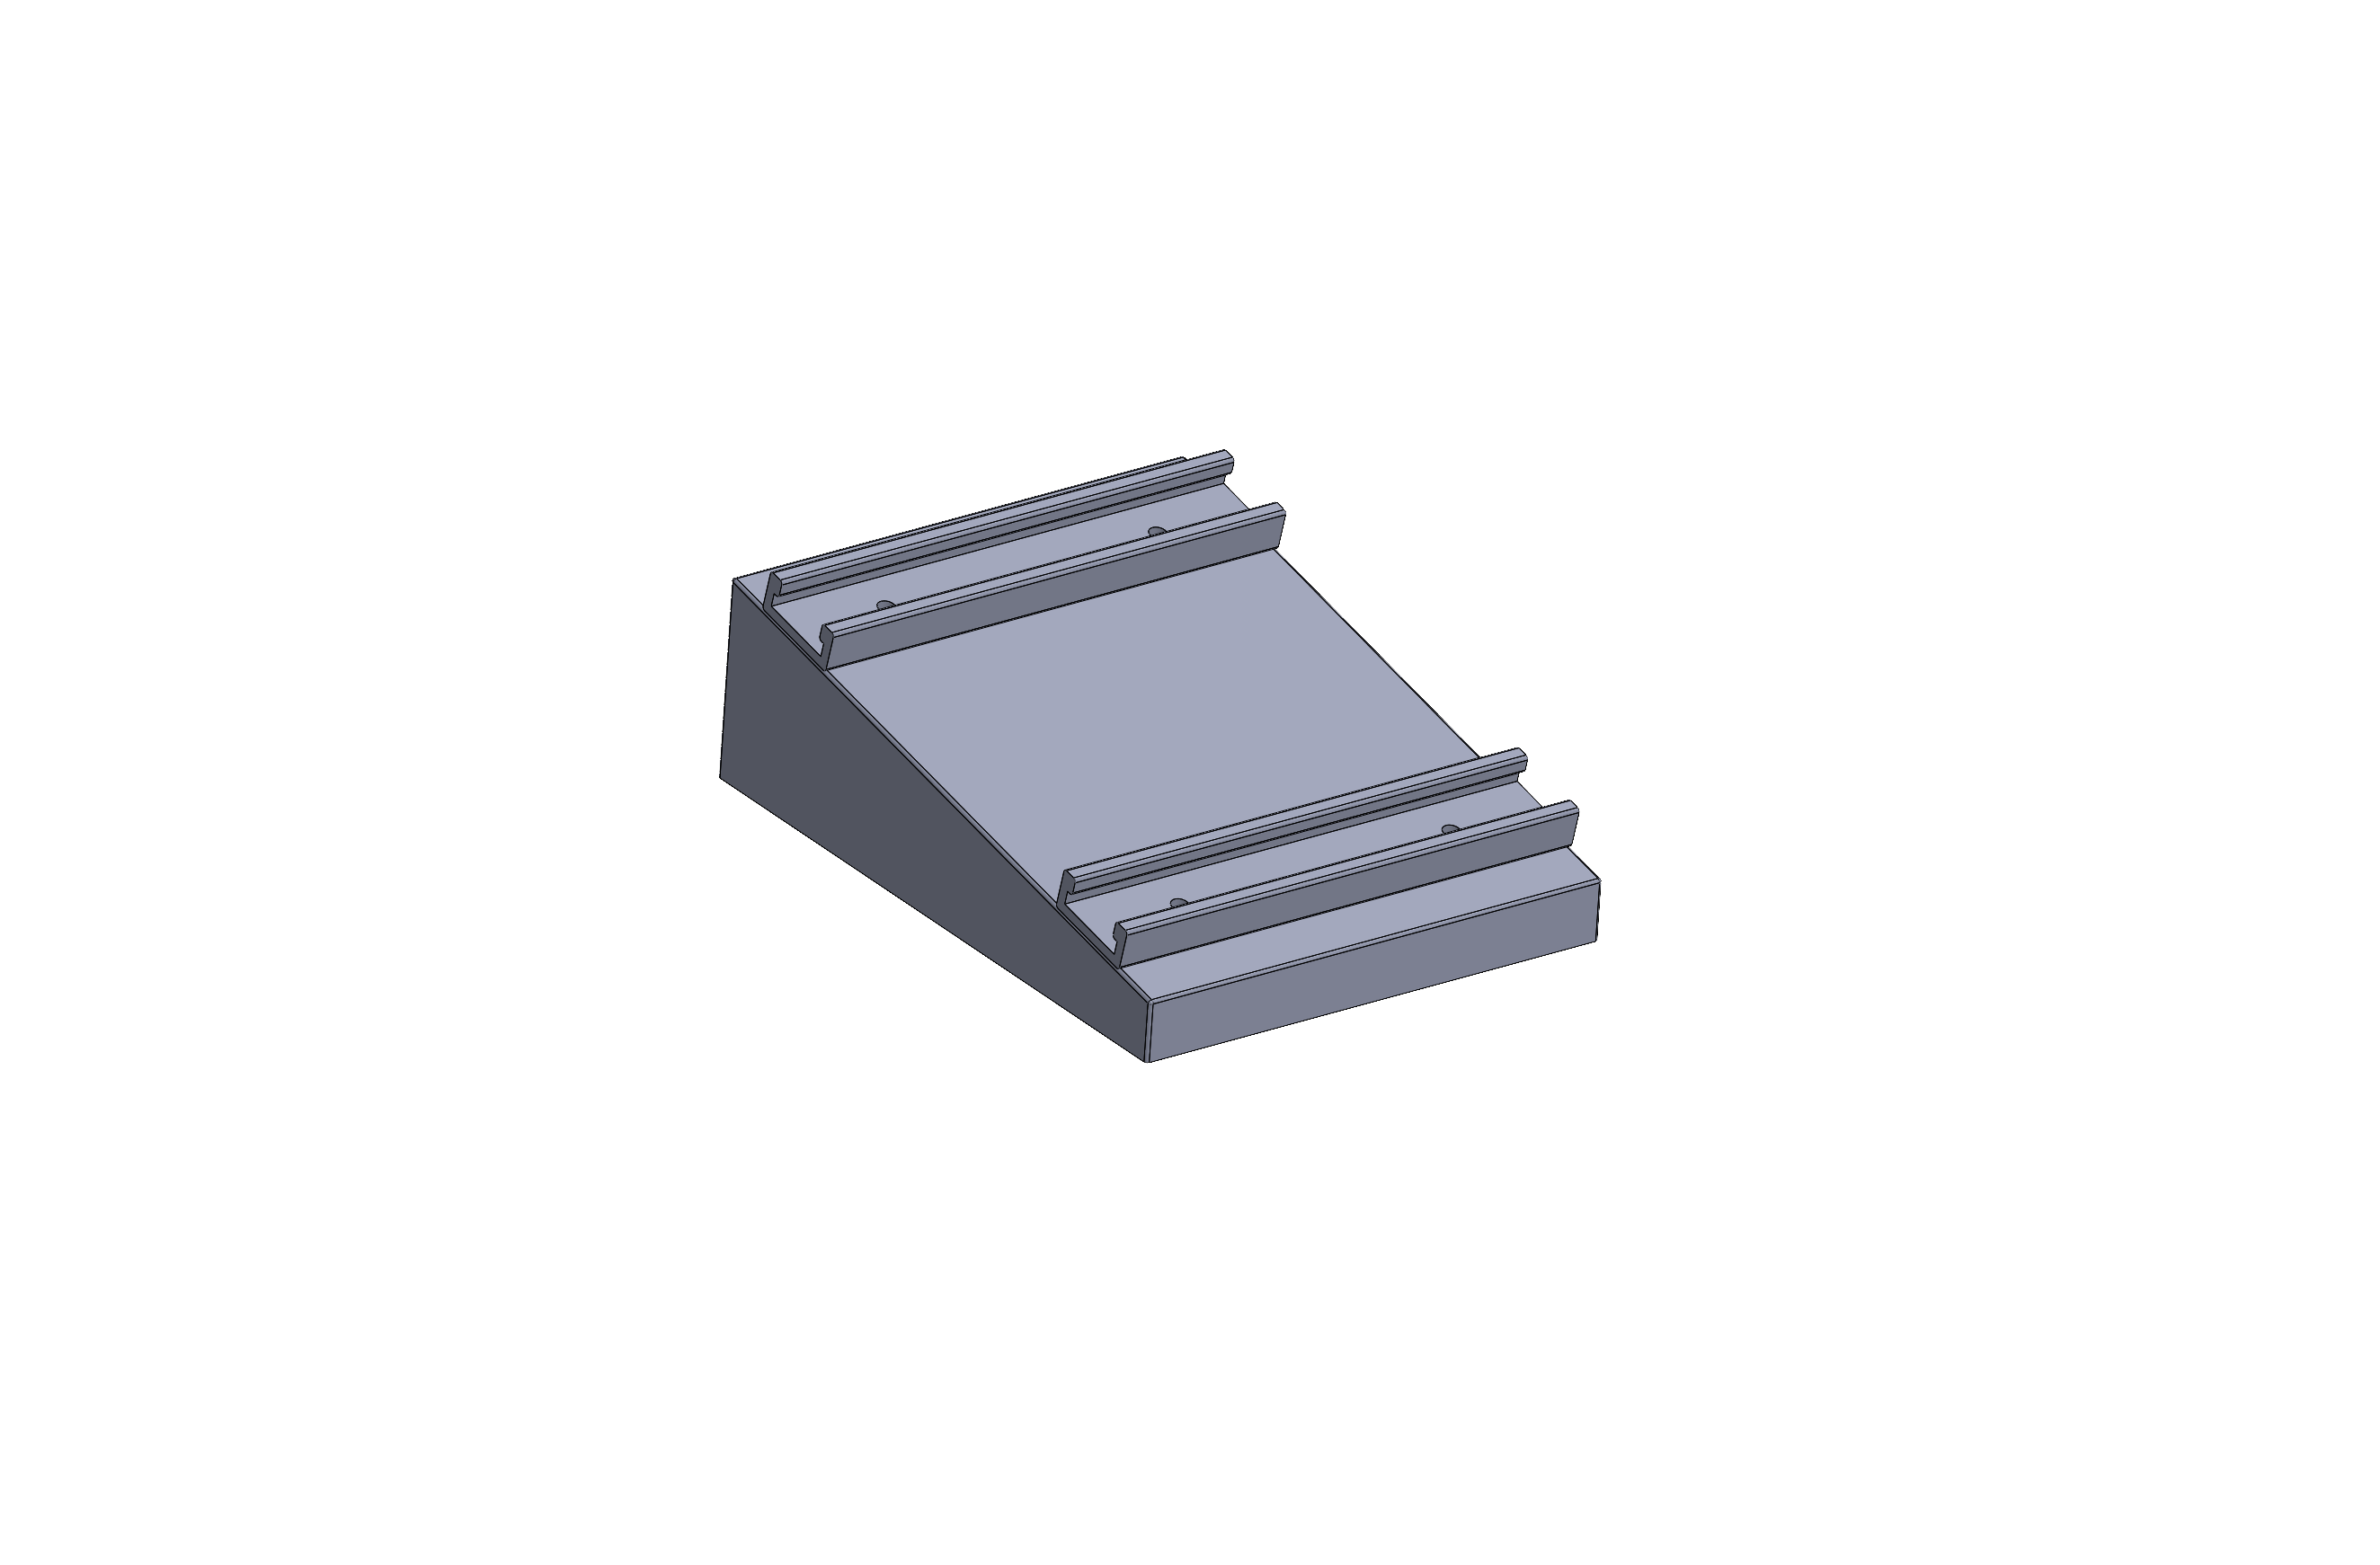
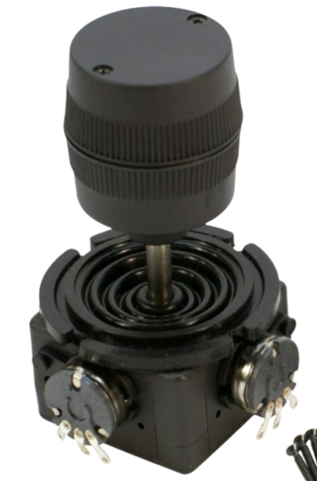
Joystick Mount CAD Model
Joystick mounting location
T track, bolted to raised platform
Cable routing
Tightening knobs for secure connection
System Decomp.
Conceptual Design
Preliminary Design
Proj. Management
Notes:
Justin

Slide 21
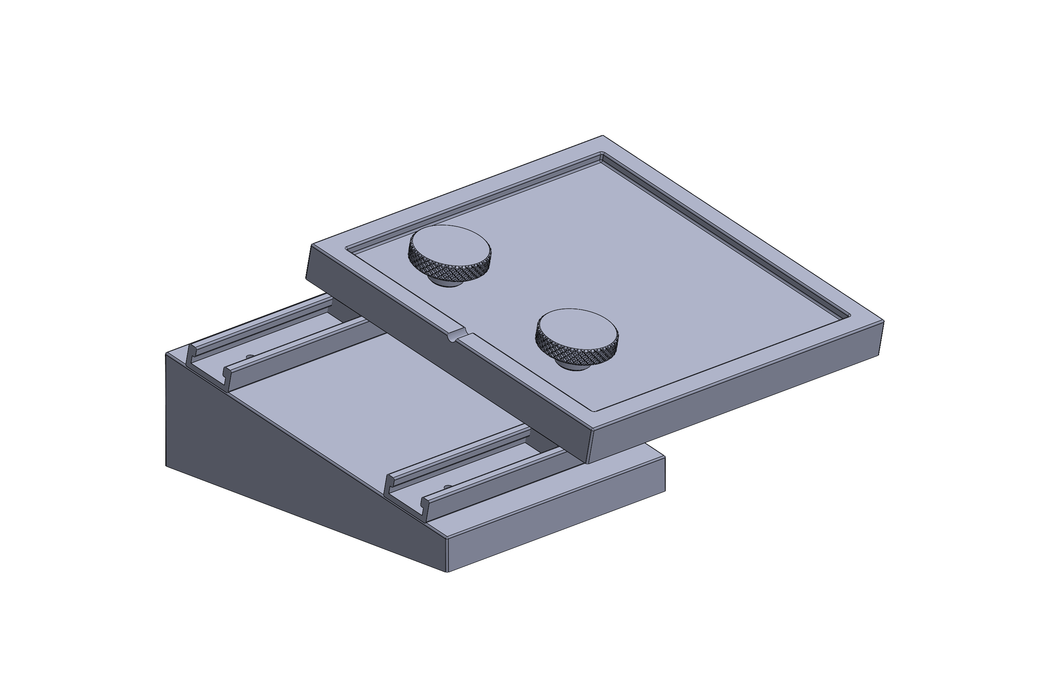
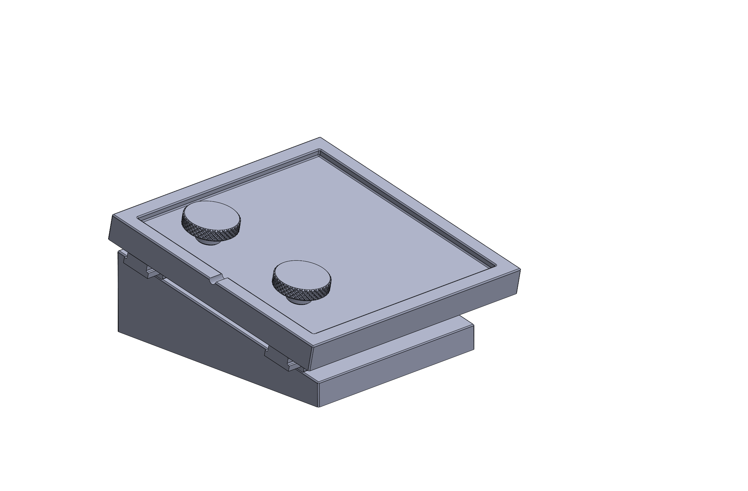
Joystick Mount CAD Model
System Decomp.
Conceptual Design
Preliminary Design
Proj. Management
Notes:
Justin

Slide 22
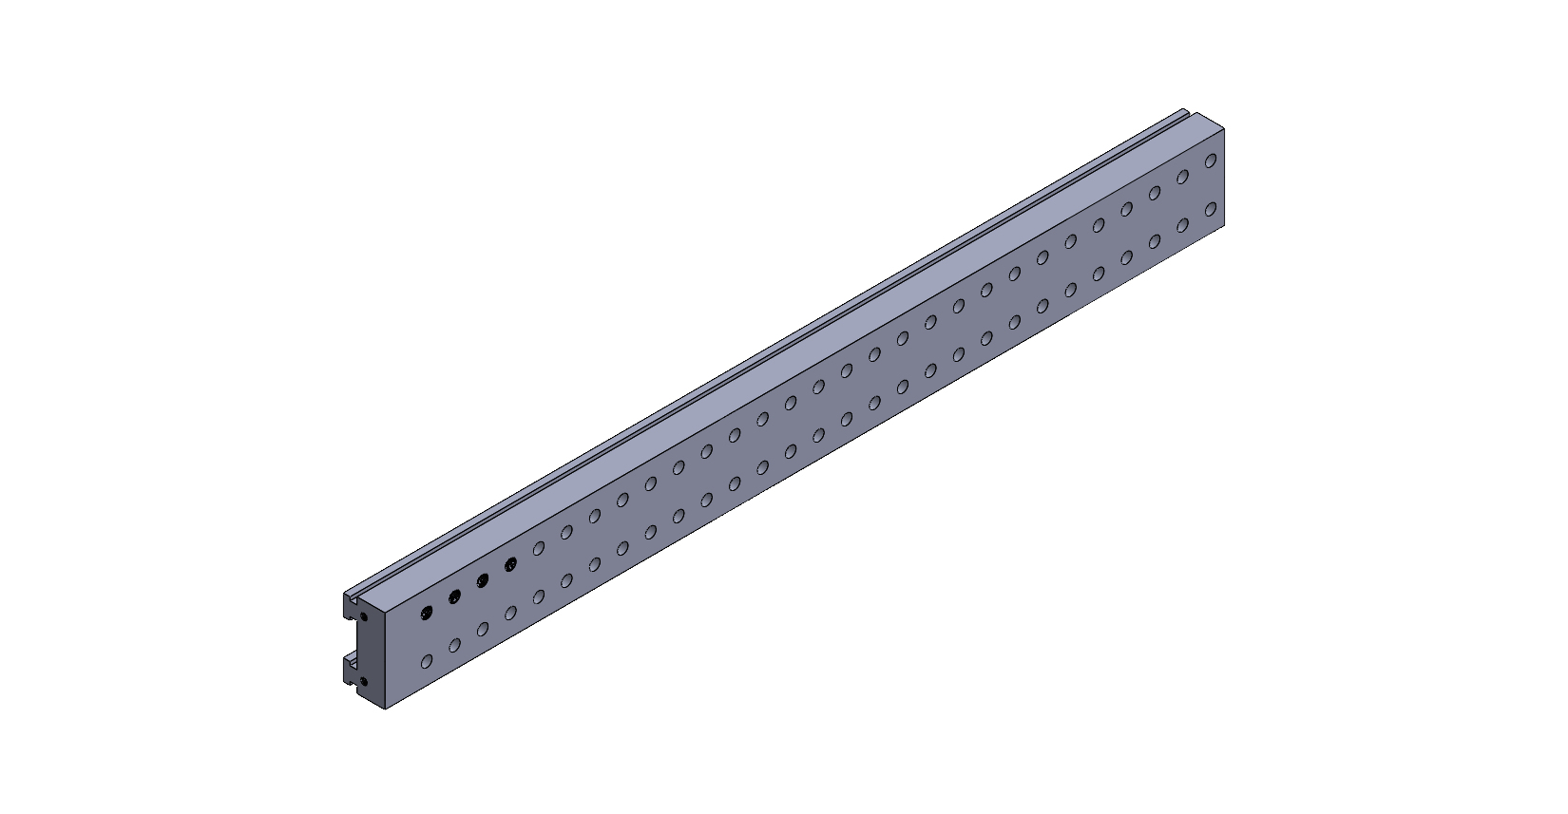
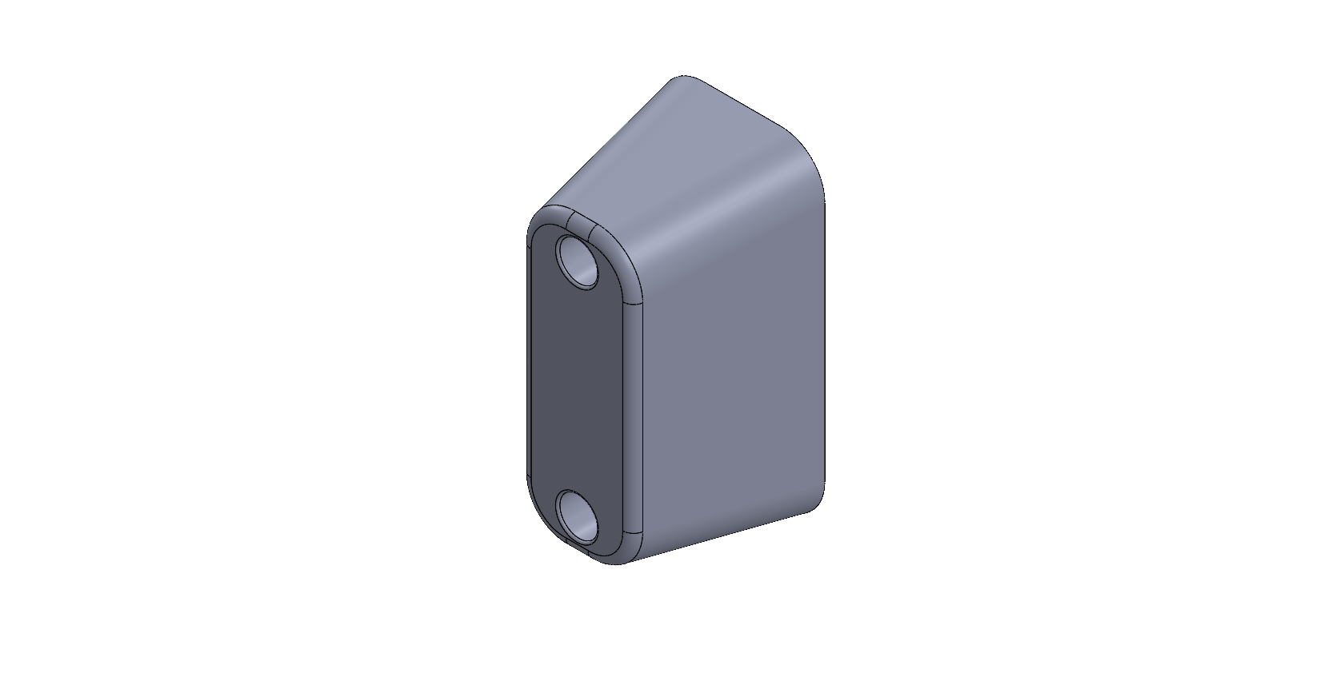
Slide and Mount CAD Model
Unitrack, bolted to the wheelchair.
Mount, provides mounting holes.
Cap, prevents mount from moving out of the slide
System Decomp.
Conceptual Design
Preliminary Design
Proj. Management
Notes:
Justin

Slide 23
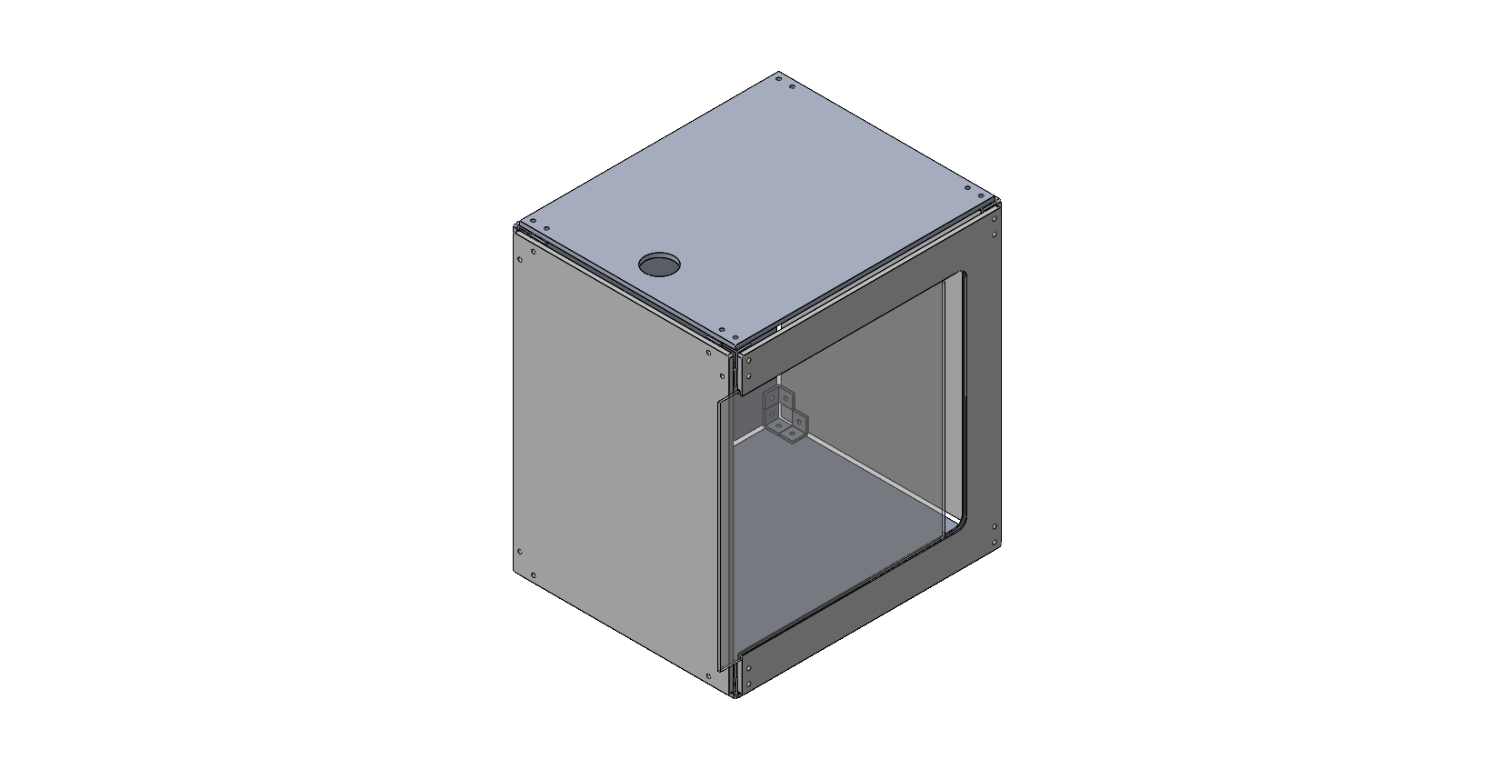
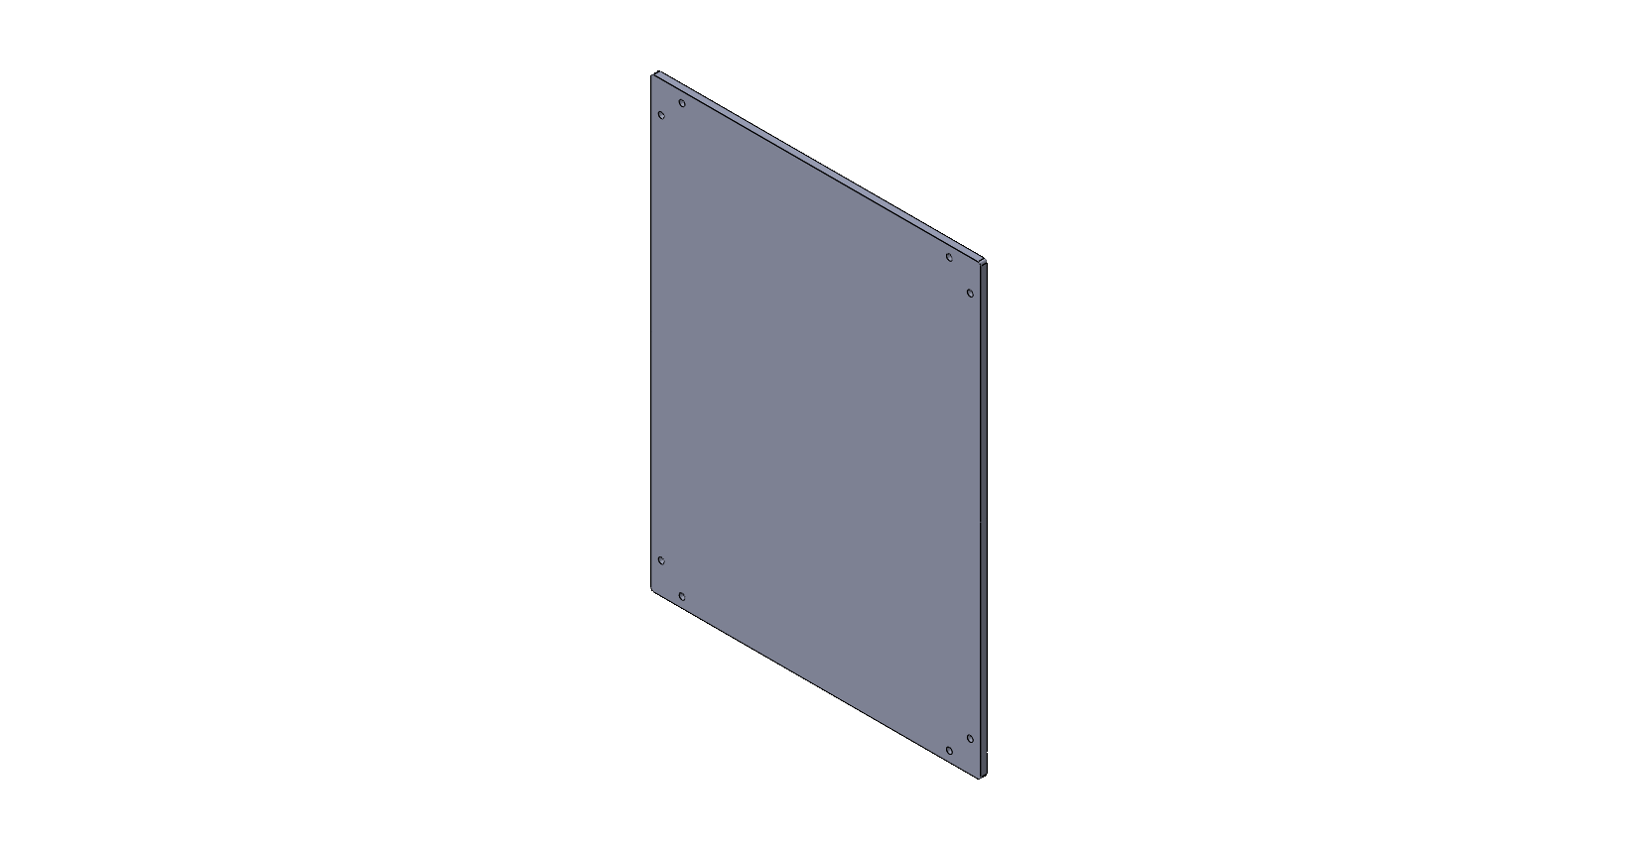
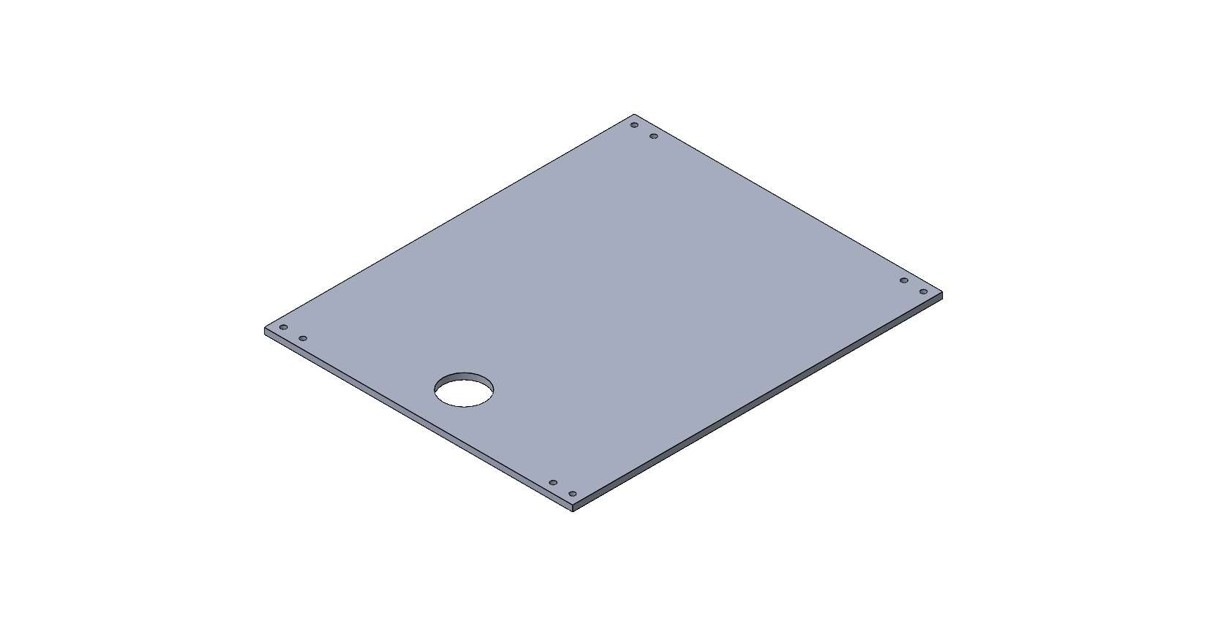
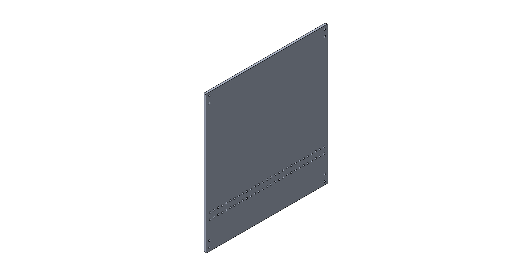
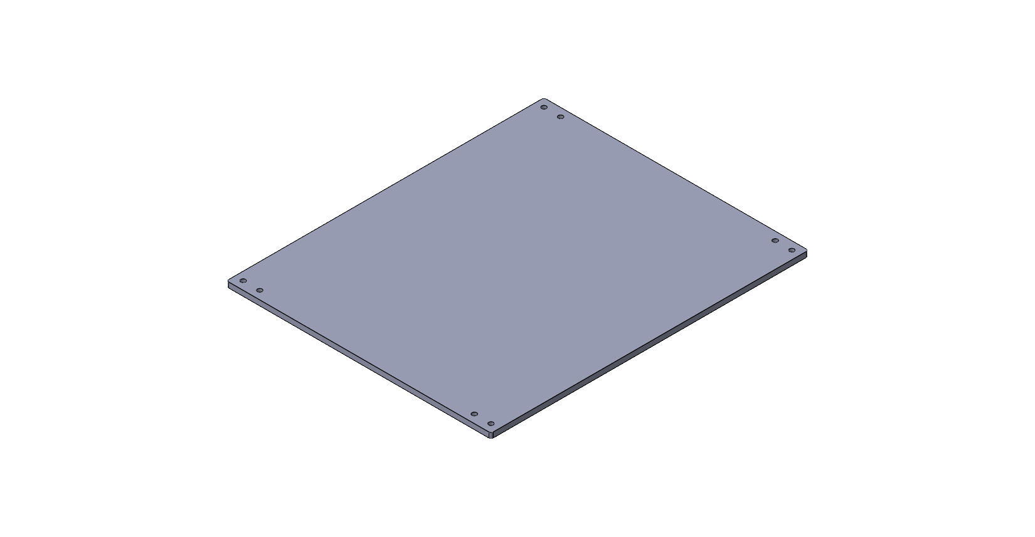

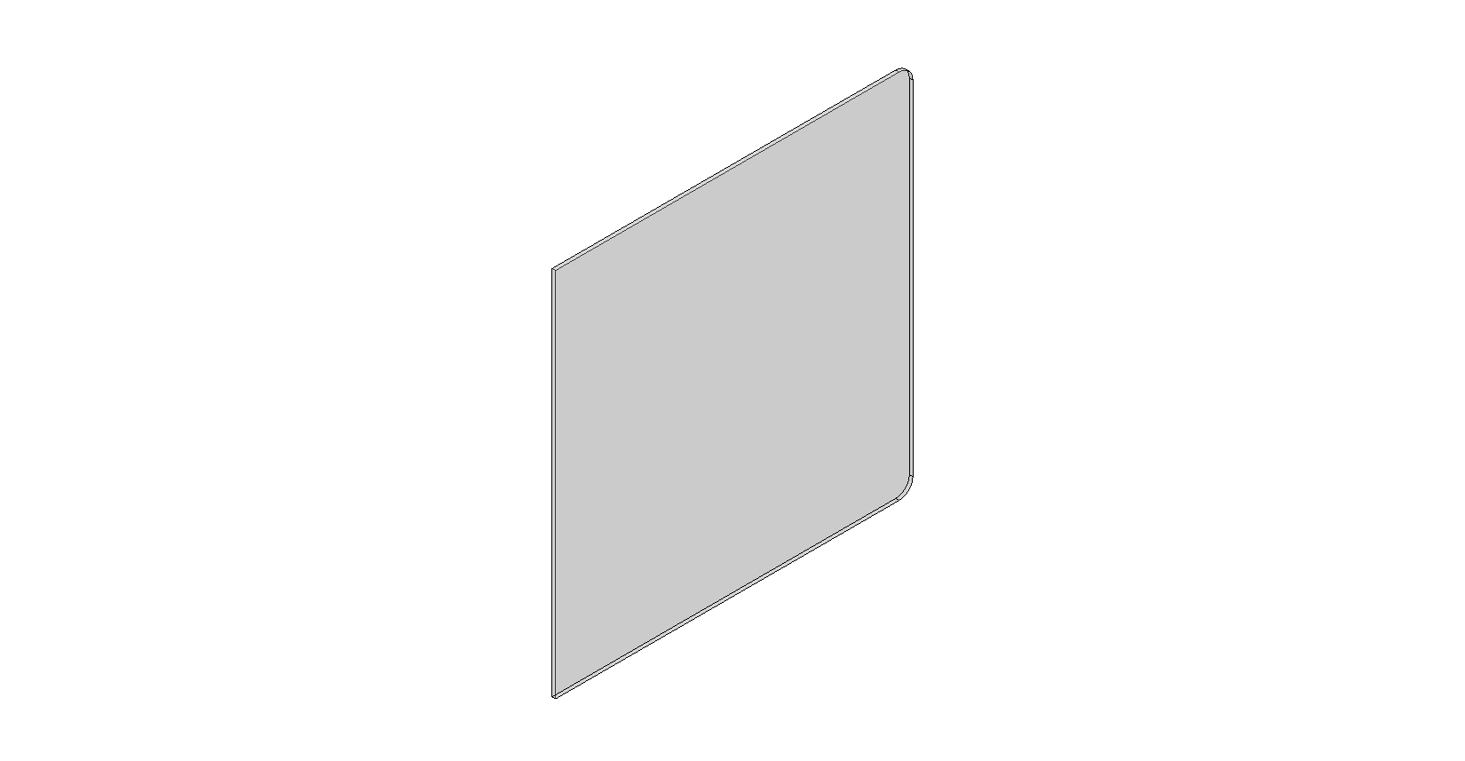
Case CAD Model
Holes that match up to the mounting points for the mount
Processing Equipment
Circuitry
Batteries
Mounting points for robot arm
System Decomp.
Conceptual Design
Preliminary Design
Proj. Management
Notes:
Justin

Slide 24
Case CAD Model
Processing Equipment
Circuitry
Batteries
Mounting points for robot arm
System Decomp.
Conceptual Design
Preliminary Design
Proj. Management
Notes:
Justin

Slide 25
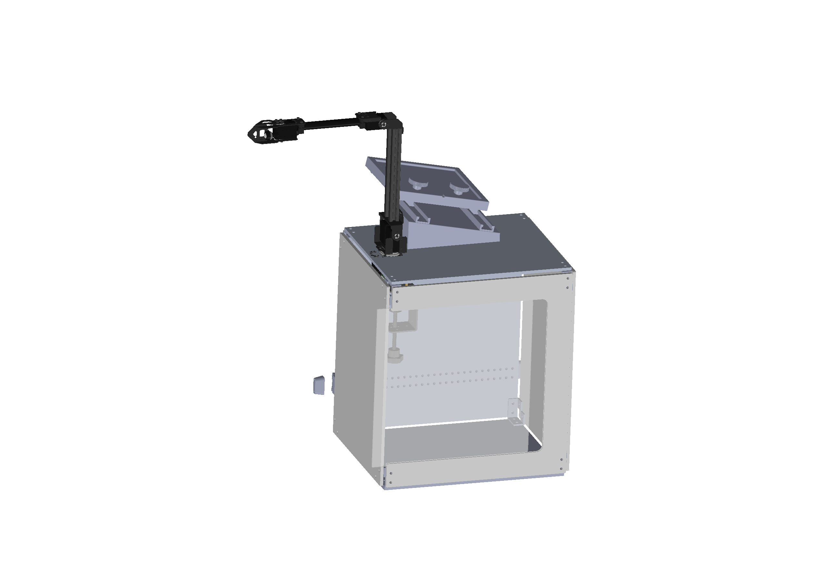
Assembled CAD Model
Unitrack, bolted to the wheelchair
System Decomp.
Conceptual Design
Preliminary Design
Proj. Management
Notes:
Justin

Slide 26
Risk and Risk Mitigation
 | Unmitigated Risks
5 | 1 | 0 | 0 | 0 | 0
4 | 0 | 0 | 0 | 0 | 1
3 | 0 | 0 | 1 | 1 | 1
2 | 0 | 1 | 1 | 1 | 1
1 | 0 | 0 | 0 | 1 | 0
 | 1 | 2 | 3 | 4 | 5
End Effector and Arms Intrusively Interacting With User
Water Contamination of Electrical Components
Electrical and Component Overheating Leading to Heat Sustained Damage
Likelihood
Severity
Mechanical and Electronic Stops to Ensure User Safety
Tolerate Ingress Protection (IP) Ratings of Enclosures and Seals – IP 65
Material Analysis, Proper Ventilation, Active Cooling
 | Mitigated Risks
5 | 0 | 0 | 0 | 0 | 0
4 | 0 | 0 | 0 | 0 | 0
3 | 0 | 0 | 0 | 0 | 0
2 | 1 | 3 | 1 | 0 | 0
1 | 1 | 4 | 0 | 0 | 0
Likelihood
System Decomp.
Conceptual Design
Preliminary Design
Proj. Management
Notes:
AJ

Slide 27
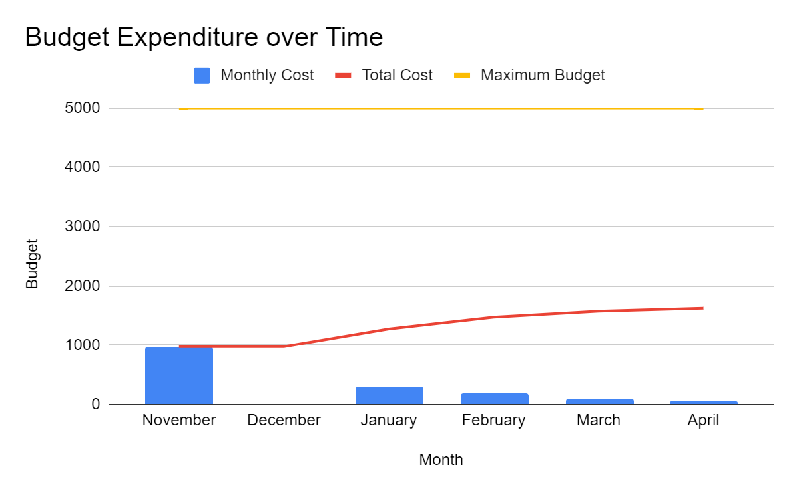
Team 205’s Maximum Budget is $5000
Unexpected Purchases
$1625.82
System Decomp.
Conceptual Design
Preliminary Design
Proj. Management
Notes:
AJ

Slide 28
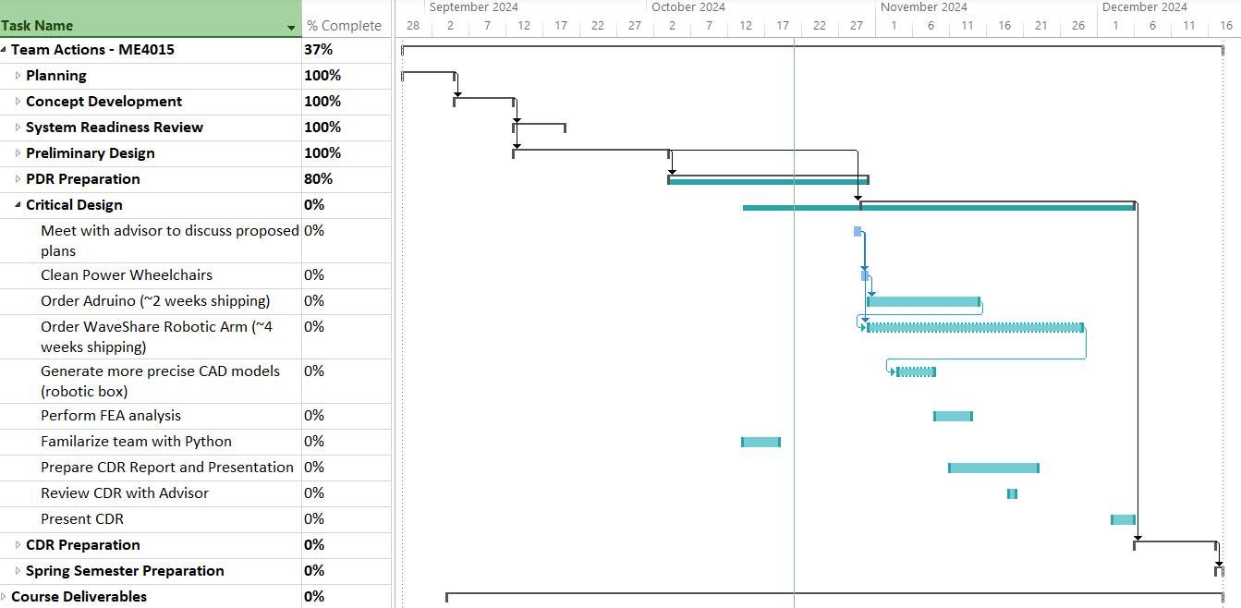
Team is Currently on Schedule for CDR Preparation
System Decomp.
Conceptual Design
Preliminary Design
Proj. Management
Notes:
Brooke

Slide 29
Conclusions and Future Work
The Team Has:
Discussed customer needs and high value functions with end user – informing requirements
Developed and down selected a concept to move forward
Assessed feasibility and risk associated with selected concept
Began developing CAD models and researching material selection
Acquired chairs to begin modifying
Determined which arm will be purchased
The Team Will:
Modify a Jazzy wheelchair to replicate mounting structure of a Permobil M3 wheelchair
Begin Prototyping
Design mounting bracket that attaches the robotic case to the side of the wheelchair
Order the robot arm and control systems
Integrate the Waveshare robotic arm and control systems onto robotic case
Learn syntax and program robotic arm,
Learn Arduino integration with ESP32
Conclusions:
Team is on track to meeting the high value functions of pushing an elevator and handicap door button
The team will continue to work closely with our customers from PPMD to ensure our prototyping process gets constant feedback from the end user
System Decomp.
Conceptual Design
Preliminary Design
Proj. Management
Notes:
Brooke
Maybe it would be good just to kind of wrap things up to mention that second bullet under conclusions since were working our way into prototyping and testing, we can emphazise that were going to continue to work close with end users to ensure our proto and test phase works towards meeting their needs

Slide 30
Thank you for your time! Questions?
Notes:
Brooke

Slide 31
Backup Slides, Additional Information

Slide 32
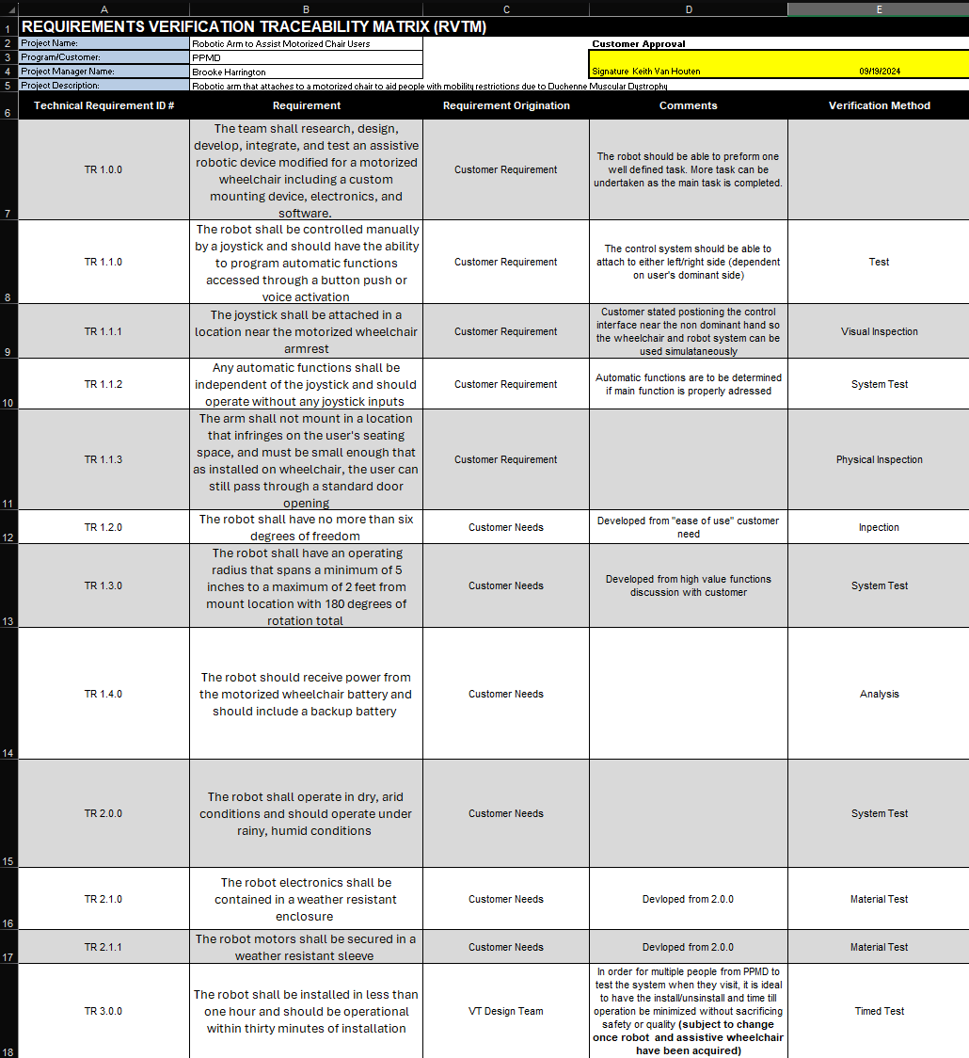
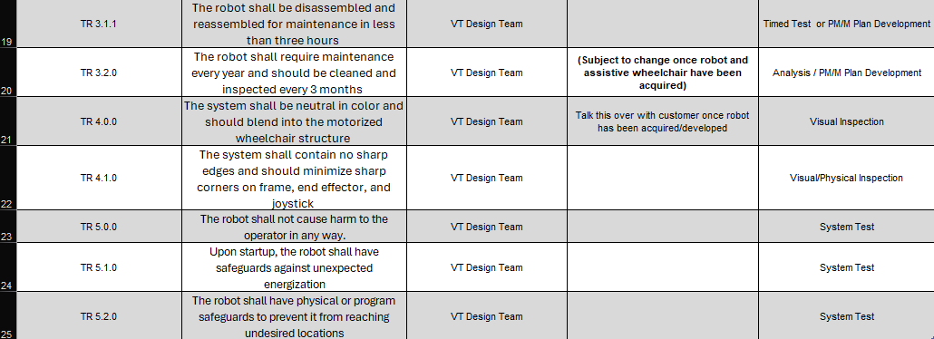
Requirements Verification Traceability Matrix

Slide 33
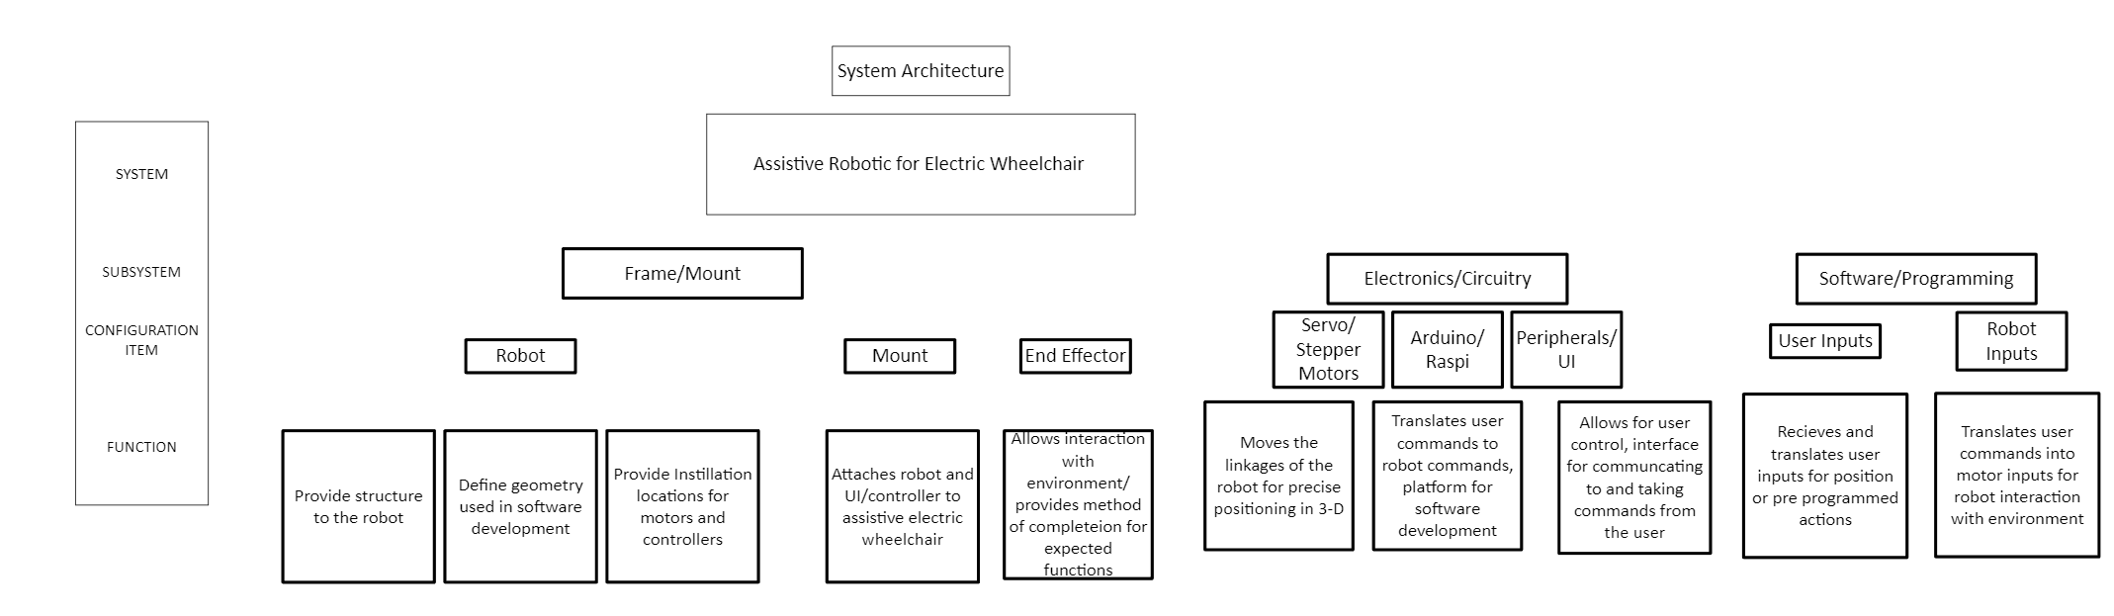
System Architecture

Slide 34
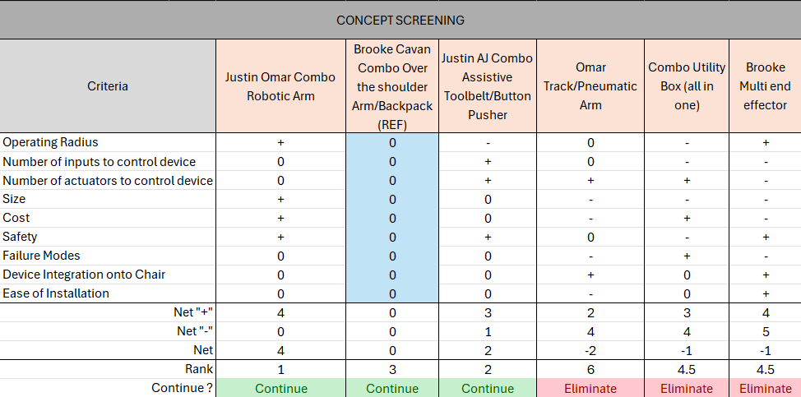
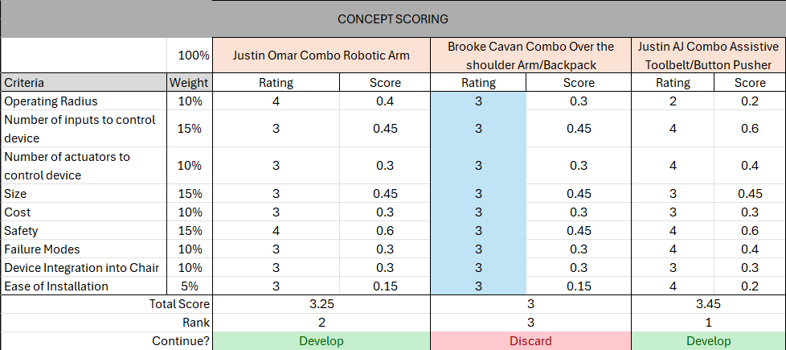
Concept Screening and Scoring

Slide 35
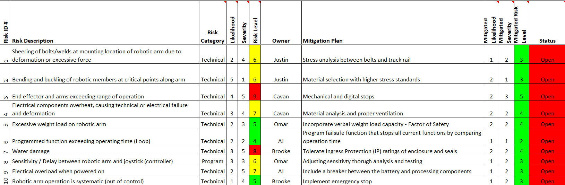
Risk and Mitigation Plan

Slide 36
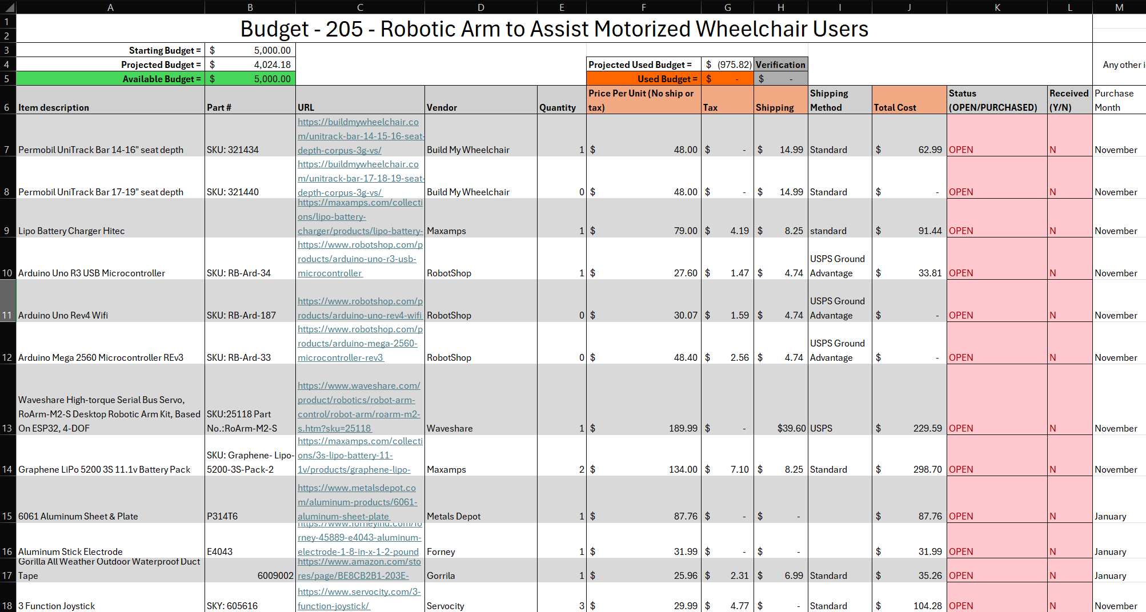
Budget Decomposition

Slide 37
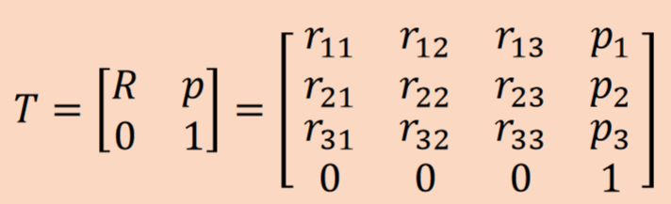
Forward Kinematics
Transformation matrix (T) displays the position (p) and orientation (R) of the end effector in reference to the base of the robot
Screws (S1,S2,S3,S4) are determined through robot geometry
M is the initial transformation matrix, showing the initial position and orientation of the end effector
T = e^([S₁]*θ₁)*e^([S₂]*θ₂)*e^([S₃]*θ₃)*e^([S₄]*θ₄)*M
Given desired θ values, the position and orientation of the end-effector can be determined

Slide 38
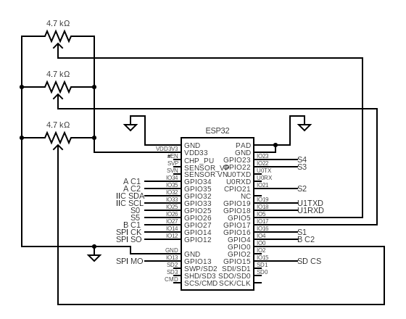
Figure XX: Circuit Diagram

